Slide 1
**NOTES ABOUT THIS PRESENTATION**
This presentation is intended to support training of assessors for the CREDI Long Form using an In-person Interview format.
The person responsible for leading this training should carefully read all materials on the CREDI website, especially the User Guide and Assessor Manual.
This person should also customize this presentation for the purposes of the particular study context.
  Suggestions of places to customize are included in red font throughout the presentation.
  This slide should also be removed from the presentation prior to use.

Slide 2

How to use the
CREDI Long Form
[Team/Study Information]
[Date]

Slide 3
Objectives of this training
Review the basics of child development and the CREDI
Understand how to use the CREDI
Practice using the CREDI

Slide 4
Training Materials
In addition to this presentation, there are several opportunities for you to learn more about the CREDI
Background materials:
  User Guide: Reviews the basics of the CREDI
  Assessor Manual: Provides instructions for using the CREDI
Testing materials:
  Long Form response form
  Long Form Illustrations
These materials are all available on the CREDI website:
sites.sph.harvard.edu/credi/

Slide 5
Understanding Child Development

Slide 6
What is Child Development?
The skills children develop in the first three years of life lay the foundation for their later wellbeing
One way to evaluate child development is through measuring milestones
  Milestones are skills, behaviors, and abilities shown by most children at specified ages
  Some milestones may differ by context, but others are more universal
  If children are delayed in reaching developmental milestones, it may indicate they are not reaching their developmental potential
The CREDI uses information from caregivers to estimate how well children within a population are doing in meeting these milestones

Slide 7
What is The credi?
The CREDI is a multi-national collaboration that started in 2013
The CREDI is a population-level measure for children under age three years
The CREDI:
  captures core developmental domains for children <36 months
  is clear/simple enough to be easily reported by caregivers
  is “culturally neutral” for global use
  is psychometrically valid/reliable
All materials (forms, translations,
guides) are freely available via
the CREDI website

Slide 8
CREDI domains
Motor
- Fine motor
- Gross motor
Language
- Receptive language
- Expressive language
Mental Health
- Internalizing
- Externalizing
+
Behaviors / Attributes
Milestones / Skills
Cognition
- Executive function
- Problem solving & reasoning
- Pre-academic knowledge
Social-Emotional
- Emotional & behavioral self-reg
- Emotion knowledge
- Social competence

Slide 9



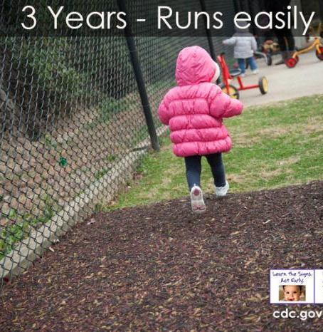
Motor milestones
Motor skills help children move and explore
6 months –Begins to sit without support
2 years- Kicks a ball
1 year- May stand alone

Slide 10

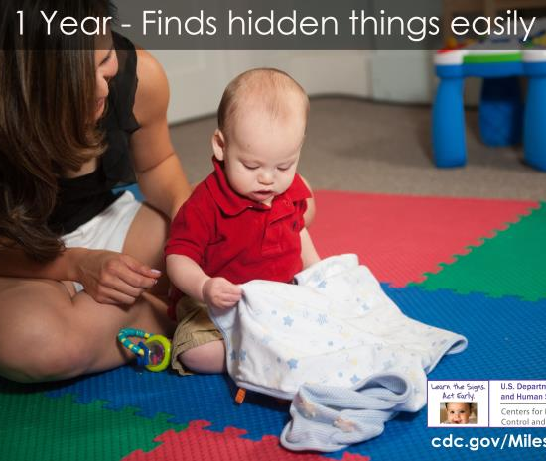

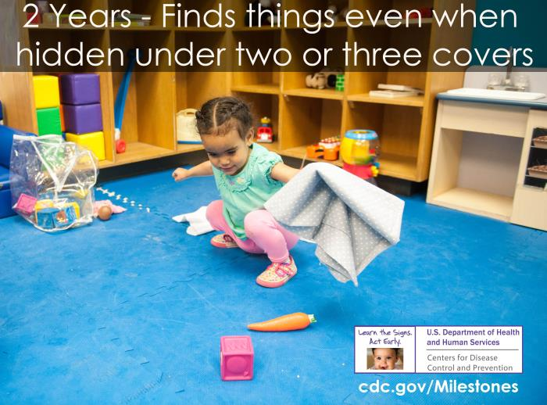
Examples of Language and Cognition milestones
Language and Cognitive skills help children to communicate, pay attention, and learn
Based on U.S. samples; milestones may vary depending on social-cultural context
6 months- Shows curiosity about things

Slide 11



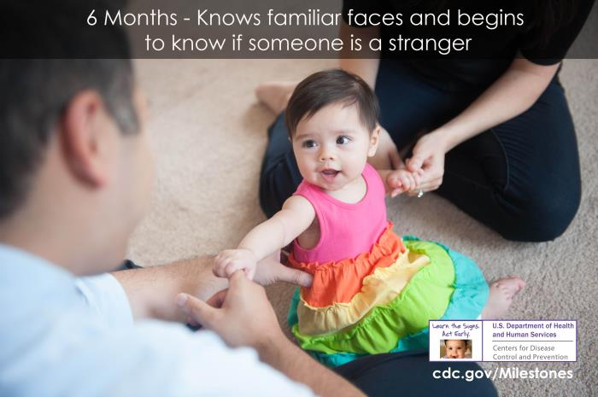

Examples of Mental Health and Social Emotional milestones
Mental health and Social-emotional skills help children to get along with others and show positive behaviors
1 year- Has a favorite thing

Slide 12
Credi items look a lot like these!
 |  |  | Yes | No | Don’t Know
Motor | Gross motor | Can the child climb onto an object such as a chair or bench? | 1 | 0 | 8
 | Fine motor | Can the child pick up a small object (e.g., a small toy or small stone) with just his/her thumb and a finger? | 1 | 0 | 8
Language | Expressive language | Can the child say one or more words (e.g., names like Mama or “ba” for “ball”)? | 1 | 0 | 8
 | Receptive language | Can the child follow orders or instructions that have more than one part (e.g., "Go get water and go to bed")? | 1 | 0 | 8
Cognitive | Problem solving & reasoning | Can the child figure out how to turn a spoon or object if you give it to him/her the wrong way around? | 1 | 0 | 8
 | Literacy/numeracy | Can the child count up to five objects (e.g., fingers, people)? | 1 | 0 | 8
Social- Emotional | Emotion Regulation | When the child is upset, does he/she calm down quickly on his/her own? | 1 | 0 | 8
 | Social Competence | Does the child have difficulty getting along with other children? | 1 | 0 | 8
 | Executive Function | Is the child often impatient or unwilling to wait when you ask him/her to? | 1 | 0 | 8
Mental Health | Internalizing | Is the child frequently sad, worried, or anxious? | 1 | 0 | 8
 | Externalizing | Does the child often kick, bite, or hit other children or adults? | 1 | 0 | 8

Slide 13
How the credi is unique
Many developmental assessments are designed to identify or “screen” children with severe delays or disabilities.
The CREDI is NOT a diagnostic tool. We do not use it for screening purposes.
CREDI is designed to measure development across a range of ability levels for large groups of children.

Slide 14
Practice
What is a milestone?
01
True or False: The CREDI can diagnose children with disabilities.
04
What are the five CREDI domains?
True or False: Kicking a ball is an example of motor skills.
02
03

Slide 15
Using the credi

Slide 16
Reminder
All of the information we will review is available in the Assessor Manual
Read this manual carefully!

Slide 17
Key terms
Long Form: This form of the CREDI is for research and evaluation purposes
Target child: This is the child who has been identified in the study as being the subject of the interview
Primary caregiver: This is the person who cares for the target child most often and who knows the most about his or her abilities and behavior
Assessor: This is the person who will be asking the survey questions to caregivers and recording the answers from these interviews

Slide 18
Credi Protocol Steps
Step 1 - Gather
Gather appropriate materials.
Step 2 - Greet
Greet the caregiver, explain procedures, and ensure his/her comfort. If appropriate, complete consent procedures.
Step 3 - Answer
Pause and make sure caregiver has time to ask questions. Answer all questions.
Step 4 - Fill Information
Record the date, participant ID number, and any other relevant information on the response form.
Step 5 - Confirm Age
Confirm the child’s age and date of birth. Select appropriate set of items for administration based on age rules.
Step 6 - Read Instructions
Read the instruction prompt exactly as written.
Step 7 - Record
Beginning at the appropriate item for the child’s age, administer each item in order, exactly as written, and record caregiver responses.
Step 8 - Review
Check all items have been completed and thank the caregiver for his/her participation.

Slide 19
Step 1 - Gather
The first step is to gather all materials you will need for your interview
These include:
  Printed or electronic copies of the CREDI Long Form response sheet
  Printed or electronic copies of the CREDI Long Form Illustrations document
  A copy of the Assessor Manual to refer to in case of questions
  [Study-specific materials, including consent forms, pens/pencils, chargers, instructions on how to get to the participant’s home, etc.]

Slide 20
Step 1 - Gather
Gather appropriate materials.
Step 2 - Greet
Greet the caregiver, explain procedures, and ensure his/her comfort. If appropriate, complete consent procedures.
Step 3 - Answer
Pause and make sure caregiver has time to ask questions. Answer all questions.
Step 4 - Fill Information
Record the date, participant ID number, and any other relevant information on the response form.
Step 5 - Confirm Age
Confirm the child’s age and date of birth. Select appropriate set of items for administration based on age rules.
Step 6 - Read Instructions
Read the instruction prompt exactly as written.
Step 7 - Record
Beginning at the appropriate item for the child’s age, administer each item in order, exactly as written, and record caregiver responses.
Step 8 - Review
Check all items have been completed and thank the caregiver for his/her participation.

Slide 21
Step 2 - Greet
Greet the caregiver and introduce yourself. Remind them of why you are there. Be polite, and make them feel welcomed and comfortable.
Find a place for the interview that is quiet and free of distractions.
Before administering any CREDI items, be sure to obtain participation consent.
  [Explain study-specific procedures here]
  Ensure that the caregiver understands the risks and advantages of answering the questions, whether the information will be kept private, and their ability to leave the study at any point in time.

Slide 22
Step 1 - Gather
Gather appropriate materials.
Step 2 - Greet
Greet the caregiver, explain procedures, and ensure his/her comfort. If appropriate, complete consent procedures.
Step 3 - Answer
Pause and make sure caregiver has time to ask questions. Answer all questions.
Step 4 - Fill Information
Record the date, participant ID number, and any other relevant information on the response form.
Step 5 - Confirm Age
Confirm the child’s age and date of birth. Select appropriate set of items for administration based on age rules.
Step 6 - Read Instructions
Read the instruction prompt exactly as written.
Step 7 - Record
Beginning at the appropriate item for the child’s age, administer each item in order, exactly as written, and record caregiver responses.
Step 8 - Review
Check all items have been completed and thank the caregiver for his/her participation.

Slide 23
Step 3 - Answer
Ask the caregiver whether they have any questions.
Answer all questions from the caregiver before moving forward with the interview.
Do not pressure the caregiver to stay if they do not wish to continue.

Slide 24
Practice
What are some materials you need to use the CREDI?
01
What is something you should do while greeting your participant?
02

Slide 25
Step 1 - Gather
Gather appropriate materials.
Step 2 - Greet
Greet the caregiver, explain procedures, and ensure his/her comfort. If appropriate, complete consent procedures.
Step 3 - Answer
Pause and make sure caregiver has time to ask questions. Answer all questions.
Step 4 - Fill Information
Record the date, participant ID number, and any other relevant information on the response form.
Step 5 - Confirm Age
Confirm the child’s age and date of birth. Select appropriate set of items for administration based on age rules.
Step 6 - Read Instructions
Read the instruction prompt exactly as written.
Step 7 - Record
Beginning at the appropriate item for the child’s age, administer each item in order, exactly as written, and record caregiver responses.
Step 8 - Review
Check all items have been completed and thank the caregiver for his/her participation.

Slide 26
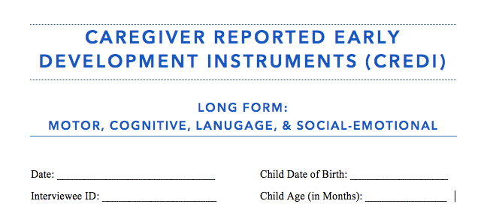
Step 4 - Fill Information
Record the date of the interview.
Record the child’s date of birth.
Record the child’s age in months. For example, if the child is 2 years and 4 months, you would record 28 months.
Record your ID number. [Insert study-specific ID information here.]
** Be sure to also record the child’s and/or caregiver’s ID number. [Insert study-specific ID information here.]

Slide 27
Step 1 - Gather
Gather appropriate materials.
Step 2 - Greet
Greet the caregiver, explain procedures, and ensure his/her comfort. If appropriate, complete consent procedures.
Step 3 - Answer
Pause and make sure caregiver has time to ask questions. Answer all questions.
Step 4 - Fill Information
Record the date, participant ID number, and any other relevant information on the response form.
Step 5 - Confirm Age
Confirm the child’s age and date of birth. Select appropriate set of items for administration based on age rules.
Step 6 - Read Instructions
Read the instruction prompt exactly as written.
Step 7 - Record
Beginning at the appropriate item for the child’s age, administer each item in order, exactly as written, and record caregiver responses.
Step 8 - Review
Check all items have been completed and thank the caregiver for his/her participation.

Slide 28
Step 5 - Confirm Age
You will start the interview at a different point depending on the child’s age.
Before starting, confirm that the child’s date of birth matches with the child’s age in months. If these do not match, ask the caregiver for clarification on which is the right age.
Items are ordered based on difficulty, with items for younger children coming first, and items for older children coming later.

Slide 29
Step 5 - Confirm Age
To begin the Long Form, you should start at the item marked on the response form with the child’s age band.
  Children 0-5 months begin with item LF1.
  Children 6-11 months begin with item LF6.
  Children 12-17 months begin with item LF11.
  Children 18-23 months begin with item LF29.
  Children 24-29 months begin with item LF39.
  Children 30-35 months begin with item LF52.
Note: A child who is 5 months & 30 days is considered to be 5 months.

Slide 30
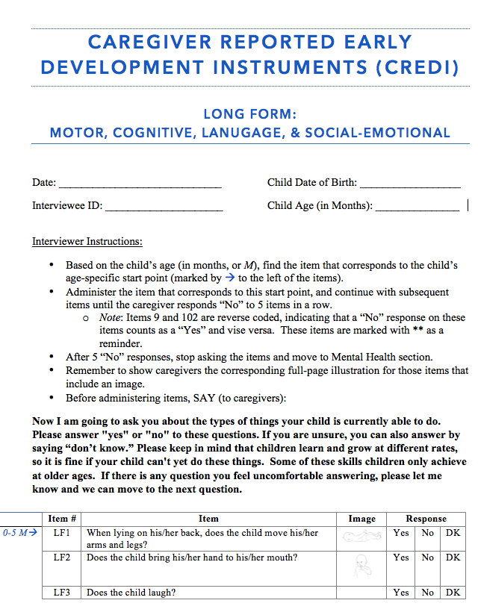
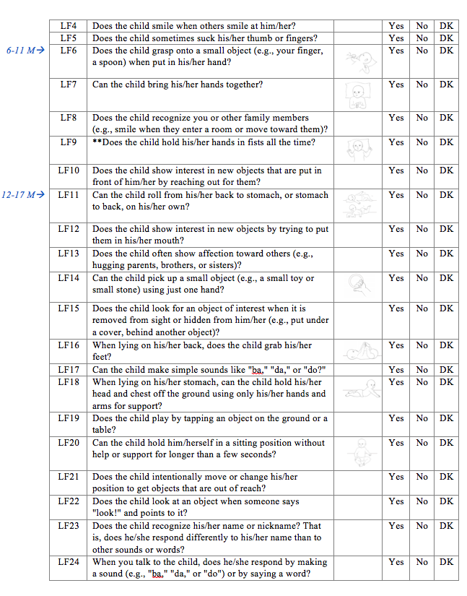
Step 5 – confirm age
A child who is 6 months starts with LF6
A child who is 17 months starts with LF11
A child who is 3 months starts with LF1

Slide 31
Practice
True or False: The ID number for participants is arbitrary. You can use whatever number you want.
01
Pretend that you are about to interview the caregiver of a 34 month old child. What year and month should this child have been born in? What item number should you start with?
02

Slide 32
Step 1 - Gather
Gather appropriate materials.
Step 2 - Greet
Greet the caregiver, explain procedures, and ensure his/her comfort. If appropriate, complete consent procedures.
Step 3 - Answer
Pause and make sure caregiver has time to ask questions. Answer all questions.
Step 4 - Fill Information
Record the date, participant ID number, and any other relevant information on the response form.
Step 5 - Confirm Age
Confirm and record the child’s age and date of birth. Select appropriate set of items for administration based on age rules.
Step 6 - Read Instructions
Read the instruction prompt exactly as written.
Step 7 - Record
Beginning at the appropriate item for the child’s age, administer each item in order, exactly as written, and record caregiver responses.
Step 8 - Review
Check all items have been completed and thank the caregiver for his/her participation.

Slide 33
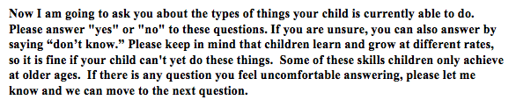
Step 6 - Read Instructions
Once you have identified where to start based on the child’s age, you may begin the interview.
Before asking the questions to the caregivers, you must read out loud the instructions that appear in bold font on the CREDI Long Form.
Read these instructions exactly as they appear.

Slide 34
Step 1 - Gather
Gather appropriate materials .
Step 2 - Greet
Greet the caregiver, explain procedures, and ensure his/her comfort. If appropriate, complete consent procedures.
Step 3 - Answer
Pause and make sure caregiver has time to ask questions. Answer all questions.
Step 4 - Fill Information
Record the date, participant ID number, and any other relevant information on the response form.
Step 5 - Confirm Age
Confirm and record the child’s age and date of birth. Select appropriate set of items for administration based on age rules.
Step 6 - Read Instructions
Read the instruction prompt exactly as written.
Step 7 - Record
Beginning at the appropriate item for the child’s age, administer each item in order, exactly as written, and record caregiver responses.
Step 8 - Review
Check all items have been completed and thank the caregiver for his/her participation.

Slide 35
Step 7 - Record
After reading the instructions, you start the interview by asking the first question relevant to the target child’s age.
Ask the question exactly as it is written. Do not change or skip any words. Do not include any additional examples, gestures, or explanations.
  Note: One exception is that you may replace “the child” with the target child’s name or “he” or “she” if you would like.
If the caregiver is unsure of how to respond, politely ask them to make their best guess.

Slide 36
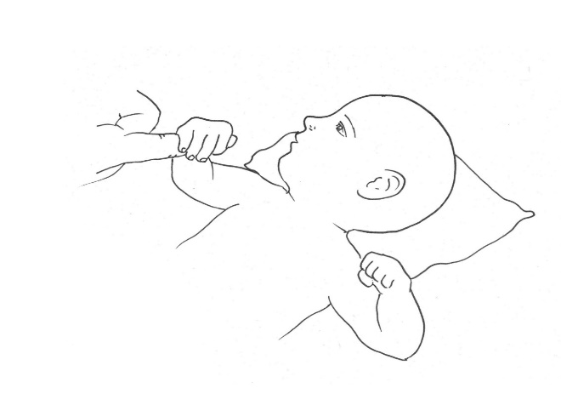
Step 7 - Record
Some CREDI items include an illustration.
These items are marked by a small picture of that image on the Long Form response sheet.
For these items, show the relevant illustration using a copy of the Long Form Illustration document. Do not show the image on the response form, as it is too small to see.

Slide 37
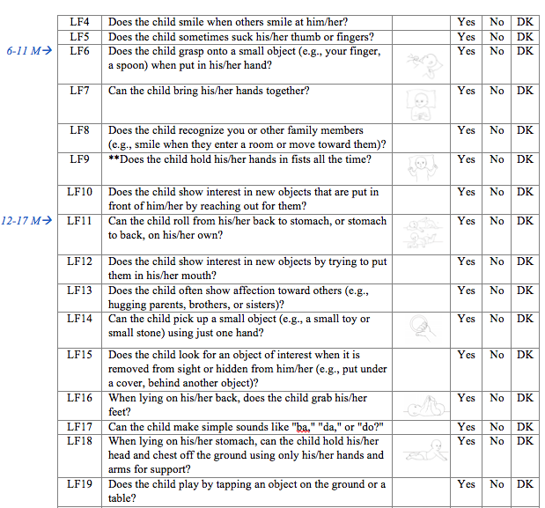
Step 7 - Record
Record the caregiver’s answer on the Long Form response sheet.
  [Insert study-specific instructions on how to record answer.]
Continue to the next question.
Continue asking questions and recording answers until the caregiver answers “No” or “Don’t Know” to 5 questions in a row. At this point, the interview is done.
  Note: For LF9 and LF102 (marked by **), a “Yes” response counts as a “No” and vise versa.

Slide 38
Practice
Practice reading the instructions to a partner.
01
Pretend your partner is a caregiver who has a 26 month old child. Select the appropriate start point of Long Form response sheet for this caregiver and administer the first 5 questions. Record their responses.
02

Slide 39
Step 1 - Gather
Gather appropriate materials.
Step 2 - Greet
Greet the caregiver, explain procedures, and ensure his/her comfort. If appropriate, complete consent procedures.
Step 3 - Answer
Pause and make sure caregiver has time to ask questions. Answer all questions.
Step 4 - Fill Information
Record the date, participant ID number, and any other relevant information on the response form.
Step 5 - Confirm Age
Confirm and record the child’s age and date of birth. Select appropriate set of items for administration based on age rules.
Step 6 - Read Instructions
Read the instruction prompt exactly as written.
Step 7 - Record
Beginning at the appropriate item for the child’s age, administer each item in order, exactly as written, and record caregiver responses.
Step 8 - Review
Check all items have been completed and thank the caregiver for his/her participation.

Slide 40
Step 8 – Review
At the end of the interview, quietly review the Long Form response sheet to make sure that there are no missing responses. If there are missing responses, ask the caregiver the item again and fill in their response.
Thank the caregivers for their participation and ask if they have any remaining questions or concerns.
Return all materials and completed forms for further processing. Materials should be returned and processed as soon as possible to minimize the possibility of loss. [Insert study-specific procedures here.]

Slide 41
Review: CREDI Protocol Steps
Step 1 - Gather
Gather appropriate materials.
Step 2 - Greet
Greet the caregiver, explain procedures, and ensure his/her comfort. If appropriate, complete consent procedures.
Step 3 - Answer
Pause and make sure caregiver has time to ask questions. Answer all questions.
Step 4 - Fill Information
Record the date, participant ID number, and any other relevant information on the response form.
Step 5 - Confirm Age
Confirm the child’s age and date of birth. Select appropriate set of items for administration based on age rules.
Step 6 - Read Instructions
Read the instruction prompt exactly as written.
Step 7 - Record
Beginning at the appropriate item for the child’s age, administer each item in order, exactly as written, and record caregiver responses.
Step 8 - Review
Check all items have been completed and thank the caregiver for his/her participation.

Slide 42
Notes to consider
If the caregiver is bored, distracted, or hesitant, take a short break to help them be more focused and comfortable.
If the caregiver is anxious or uncomfortable, remind them that there are no right or wrong answers. Say that children grow at different rates, and that what is normal for one child may be different from what is normal for another. Let them know that some of the questions are meant to be difficult, and that most children cannot do all of the behaviors listed because they are still young.
If the caregiver expresses concerns regarding their child’s abilities, you should tell the caregiver that the interview is not meant to diagnose the child. You should refer the caregiver for additional services, if desired. [Insert study-specific procedures here.]

Slide 43
Practice
Find a partner and practice the entire CREDI Long Form interview from start to finish. Ask your partner for feedback on your performance. Switch roles so that each of you has the chance to practice in the role of assessor and caregiver.
01

Slide 44
Questions?
What questions do you have about the CREDI?
If you have questions later on, you should contact [study-specific contact information] for help.

